Slide 1
Universal Charging Friend
U.C.F.
Group A
Fall 2010
Alfred Berrios
Tristan Byers
Melanie Cromer
Michael Matthews

Slide 2
Project Description
The Universal Charging Friend (UCF) is a portable charging unit
Capable of being charged by three input sources
  AC-DC wall adapter
  Fold-out solar panels
  Hand-crank kinetic generator
Has the ability to charge USB devices
Displays important information on an LCD

Slide 3
Project Motivation
Today’s world demands more green energy technology and solutions to save money and the environment
Creating a project that utilizes three different power sources and designing an efficient charging/discharging method would greatly enhance our knowledge and experience in this field
Knew it would require us to accumulate resources and combine learned materials from engineering courses to make a working product
Wanted a project that could be used in every day applications

Slide 4
Project Overview
Designed a circuit that harnesses solar and kinetic energy to trickle charge an internal battery
Designed a circuit that discharges the battery into a USB load
Designed a circuit that uses a wall adapter to fast charge and trickle charge the battery
  Also charge a USB load simultaneously
Created a program that performs analog-to-digital conversions and displays those values on an LCD
  Inform the user of which input source is charging the battery as well as the status of the battery
Created a program that makes the project efficient by turning off the backlight after ten seconds and detecting low battery which automatically disconnects the battery from the USB load
  Preserves the life of the battery

Slide 5
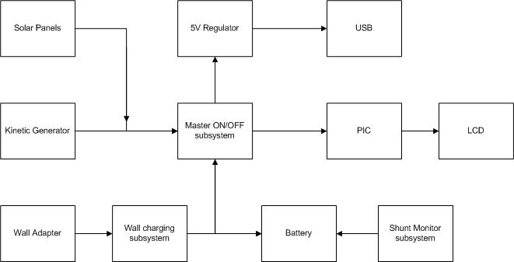
Block Diagram of System

Slide 6
Project Specifications
Dimensions of the unit:
  19cm x 9cm x 9cm
Operate at any temperature between -15 and 75 degrees Celsius
Maximum input source voltage of 17V (before voltage dividing) for accurate ADC measurements
Maximum regulated voltage of 5V for nominal circuit operation
7.2V 1200mAH NiMH battery

Slide 7
Project Requirements
Light-weight and portable
Power efficient
  Consume very little power without a load
Charge USB devices via internal battery
Receive input power from solar, kinetic, and wall sources to charge internal battery
Contain a button to power the unit on and off
  Also turn the backlight on after a period of inactivity
Contain diodes to prevent backflow current from damaging components

Slide 8
Project Requirements
Contain regulators to prevent damage to internal components
Contain heat sinks for heat dissipation to prevent component malfunctions
Program will detect low battery and will automatically power down the unit and disconnect the battery from the USB load in order to preserve the life of the battery
Wall adapter charging circuit will perform a fast charge cycle until the battery is almost full and then switch to a trickle charge cycle
  Will also charge a USB device at the same time

Slide 9
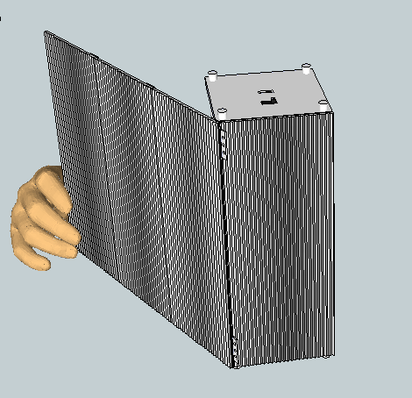
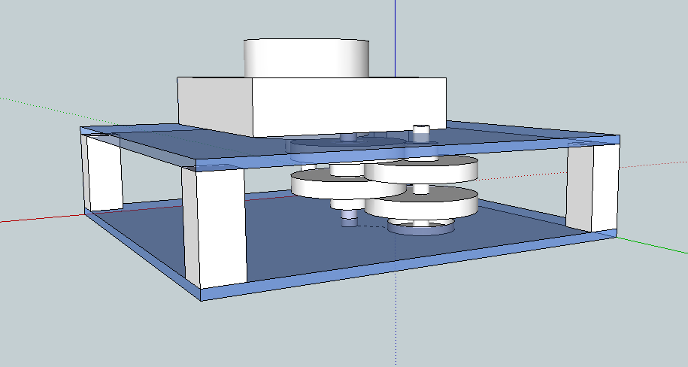
Power Sources
Solar
Kinetic
Power from wall outlet (through a DC adapter)

Slide 10
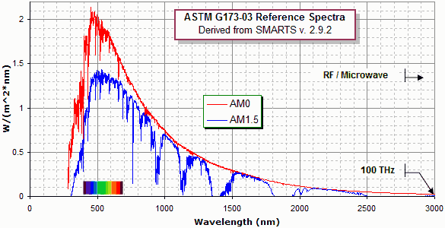
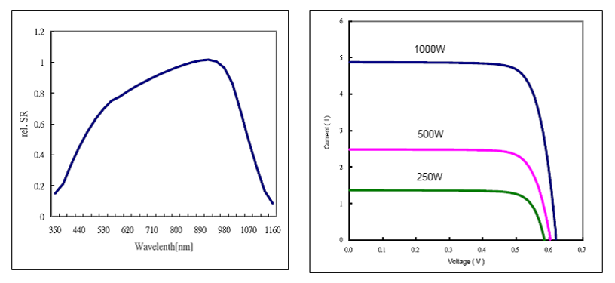
Solar Power Available
Spectral Performance

Slide 11
Solar Cell Output
Current vs. Voltage Curve

Slide 12
Silicon Solar IS 125-E Solar Cells
Electrical Specifications
Model | IS 125-E
Efficiency | 13.00 – 14.49%
Power (Ppm) | 1.93 – 2.15W
Max Power Current (Ipm) | 4.30A
Min Power Current (Isc) | 4.65A
Max Power Voltage (Vpm) | 0.479V
Open Circuit Voltage (Voc) | 0.602V
Data under Standard Testing Conditions (STC) | 1000W/m², AM1.5, 25°C
Note: specific cell recipe was not made available.

Slide 13
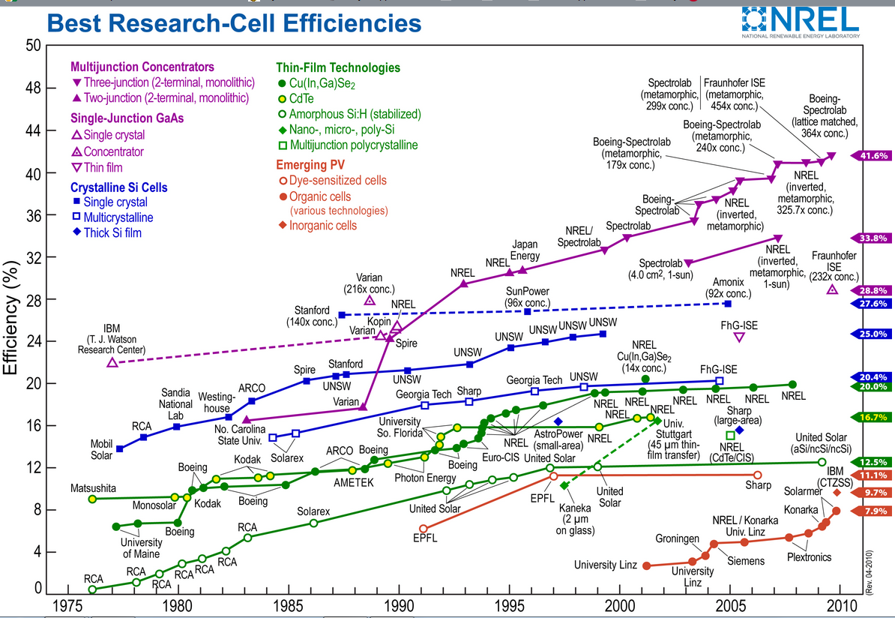
Types of Solar Cells

Slide 14
Solder Ability
Side | Peel Strength
Front Side Average | > 1.7 N/mm
Back Side Average | > 1.6 N/mm
Minimum | > 1.2 N/mm
Ribbon Width: 2 mm
Solder at 300-400°C with no clean flux

Slide 15
Module Design
27 cells rated at 700mA per cell at .55V
All cells connected in series at 14.85V
Total expected output power is 10.395W
Actual voltage is 14.57V
Actual current is 350mA
Max power is 3.82W

Slide 16
Assembly of U.C.F.
Main structural components
  Acrylic plates
  Steel studs
  Two part epoxy
  Steel hinges
UCF machine shop tools
  Mill
  Band saw
  Drill press
  Dremel

Slide 17
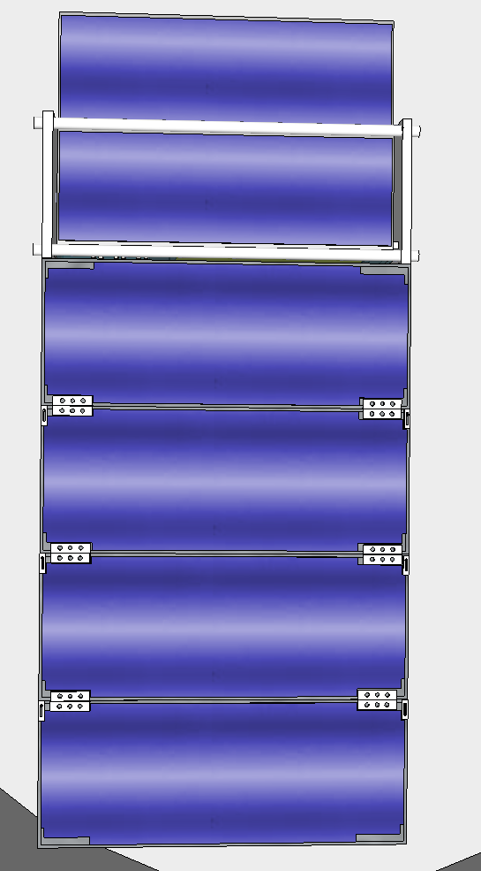
Available Charging Area
Dimensions of the portion of each panel available to support solar cells is 9 in. x 3 in.
Actual - 3 panels used
For design improvement, six panels could be added for use as platforms for the solar module

Slide 18
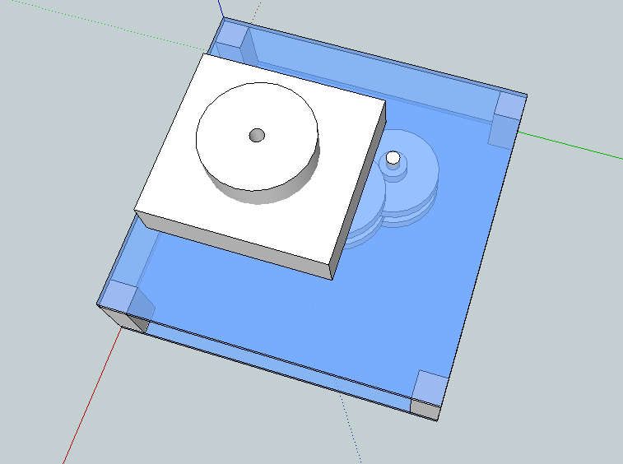
Kinetic Power
Requirements:
Compact and light
Simple to use
Acceptable power output
Low cost
Reliable and robust

Slide 19
Materials Used for the UCF Kinetic Generator
A DC motor obtained from a surplus store
A network of gears which connect to the shaft of the motor
A handle used to spin shaft of the motor via the network of gears
Plexiglass for mounting on parts

Slide 20
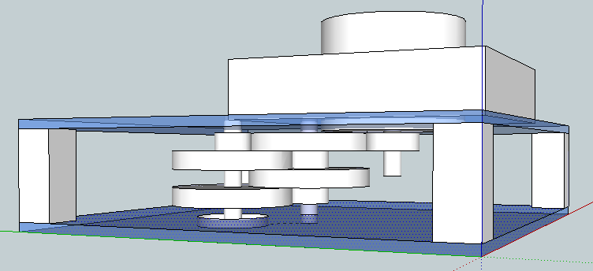
Gear System
The gear system consists of five gears
For every three revolutions that the user makes, ten revolutions occur in the adjacent gear
For every full revolution the user makes with the handle, approximately 118 revolutions occur on the shaft of the motor
Motor
4
5
3
1
2
Handle

Slide 21
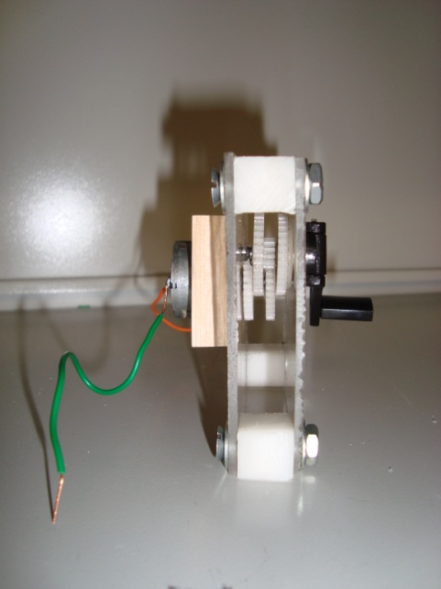
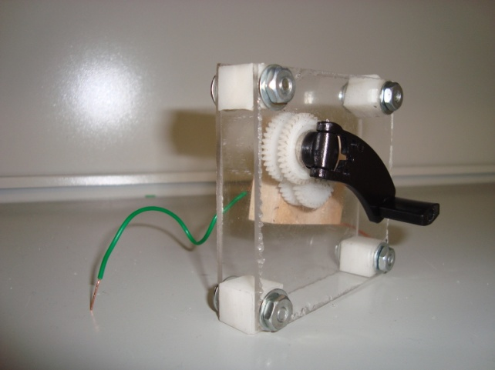
Final Design of Kinetic Generator
Generates 5VDC - 10VDC after passing through a full-wave bridge rectifier
Produces 250mA to 400mA
Trickle charges battery only

Slide 22
Wall Power
Wall adapter regulates 120VAC to 15VDC
Delivers 2.5A in order to fast charge internal battery and USB load (if any) simultaneously
  Solar and kinetic sources do not provide enough power to fast charge the battery, but the wall adapter allows the user to charge the UCF quickly

Slide 23
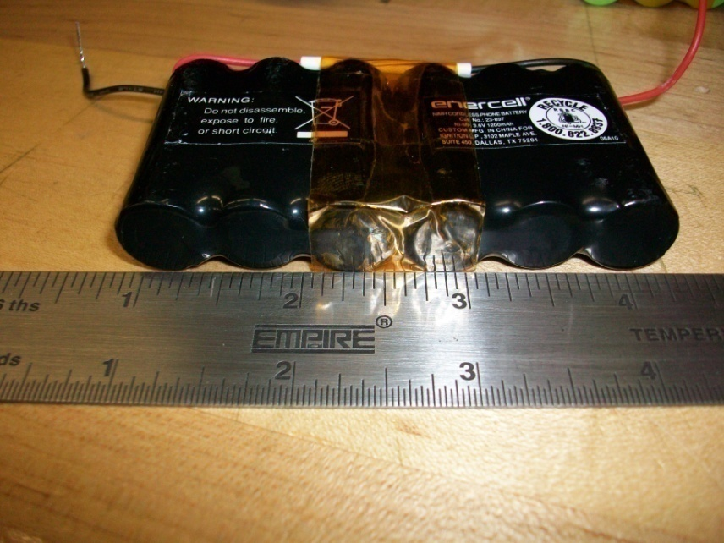
Battery
Specifications: NiMH
Voltage: 7.2V
Capacity: 1200mAH
Standard charge: 3 hours
  For demonstration purposes we will charge a 7.2V NiMH 600mAH to validate fast and trickle charge modes

Slide 24
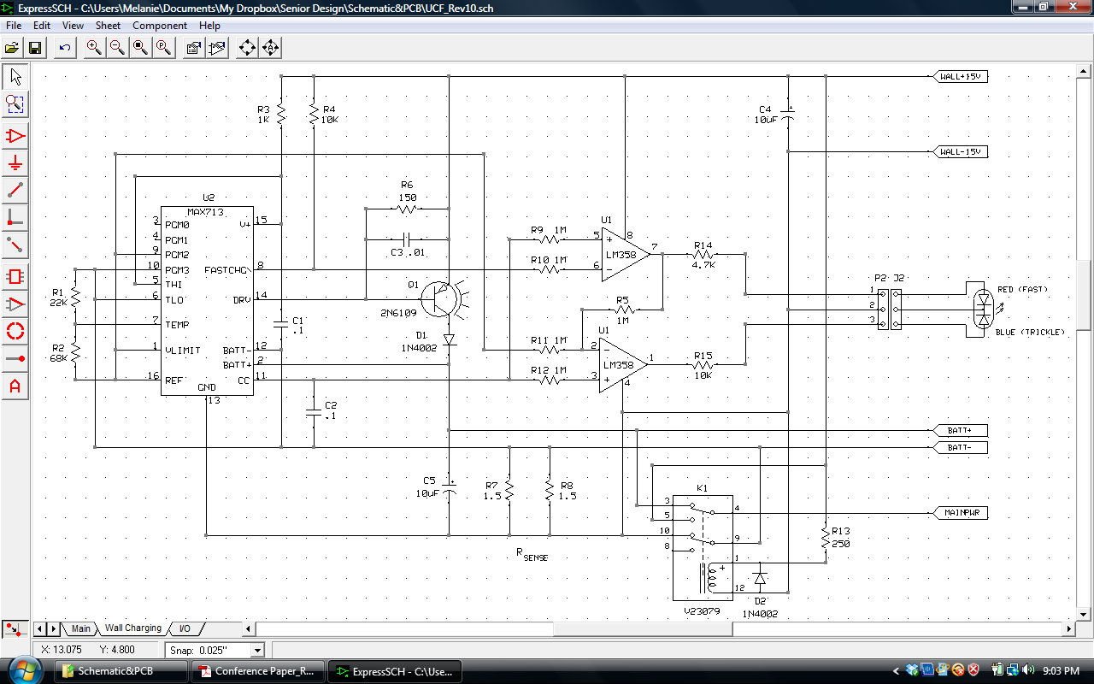
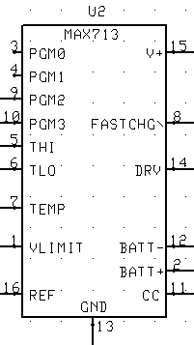
Wall Charging Schematic
MAX712/713 fast charge
controller is powered by the
15VDC wall cube
MAX chip is configured
based on 6 NiMH cells, the
fast charge rate of C/2, and
the 15VDC input source
Key pins:
PIN 15 – shunt regulator
PIN 14 – drives PNP current source
PIN 8 – fast charge status output
PIN 11 – constant current

Slide 25
MAX713
The MAX713 monitors voltage slope, battery temperature, and charge time
During fast charge, the current level is high; once full charge is detected, the current reduces to trickle charge
5µA (max) drain on battery when not charging
Fast charge on the circuit was measured at 340mA
Trickle charge was measured around 30mA

Slide 26
UCF Schematic
The UCF schematic can be divided into four main sections:
  Power Control System
  Power Sources/Battery System
  Wall Adaptor Charging System
  Microcontroller and LCD System

Slide 27
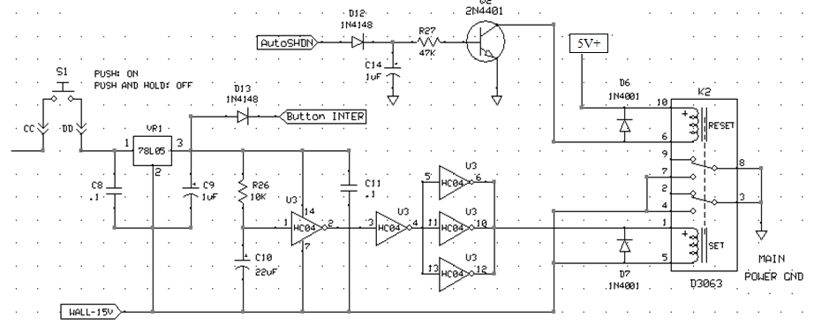
Power Control Schematic
The power control section consists of a:
Main push button
5V linear regulator (78L05)
Hex inverter (HC04)
Latching relay (D3063)
Two diodes

Slide 28
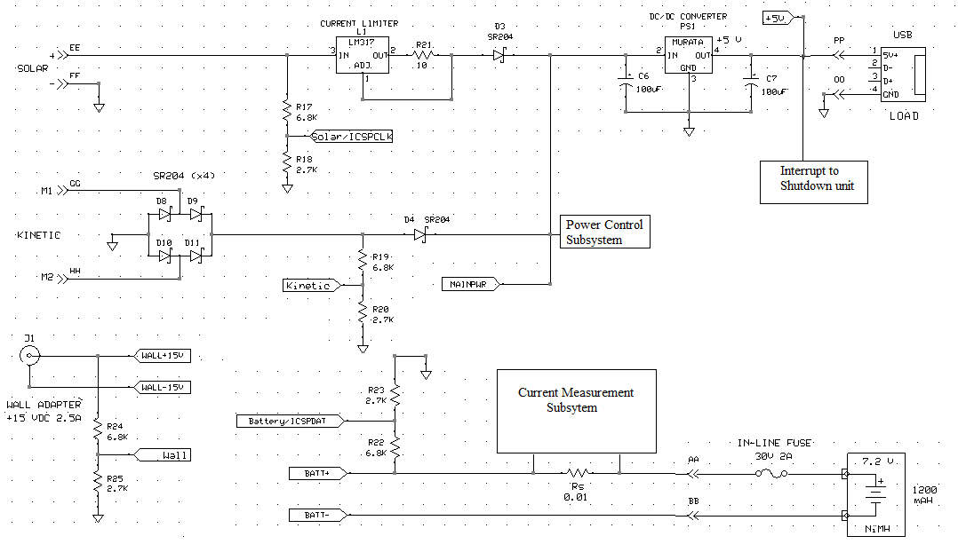
Power Sources/Battery Schematic
The power supply and battery section consists of a:
Solar power supply
Current limiter
Kinetic generator
Schottky diodes (x4)
Battery
Fuse
Wall adapter jack
DC/DC regulator
USB port
Resistors
Capacitors
Diodes

Slide 29
Wall Charging Schematic
The wall charging schematic consists of a:
Maxim713 IC
Transistor (with heat sink)
Latch
Two comparators (LM358)
Bi-color LED
Various resistors
Various diodes
Various capacitors

Slide 30
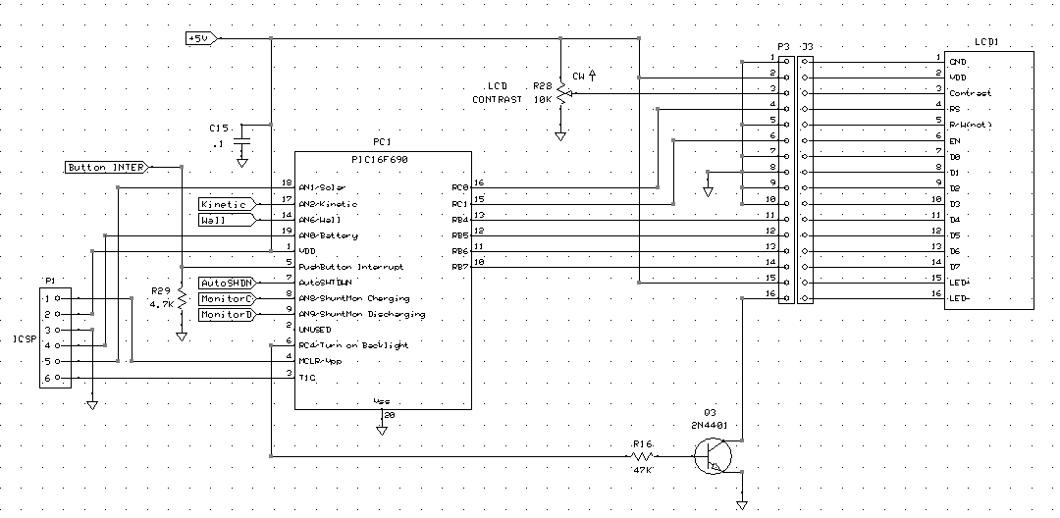
Microcontroller and LCD Schematic
The wall charging schematic consists of a:
PIC16F690 microcontroller
HD44780 LCD display
2N4401 transistor
10K potentiometer
Resistors
Capacitors

Slide 31
Microcontroller and LCD

Slide 32
MCU: PIC16F690
Single chip is implemented into the design
  Monitor all 3 input voltage sources
  Monitor the battery
  Perform analog-to-digital conversions
  Send data to LCD driver for display
Operates at 220µA
Standby uses 50nA
Can operate in ambient temperatures up to 125˚C
Programmed with mikroC compiler using C code and the PICKit2 software to write to the chip

Slide 33
MCU Routines
The microcontroller contains functions that perform the following:
  Sample ADC ports and perform conversions
  Send converted values to LCD driver
  Turn off backlight after ten seconds
  Read interrupts to turn on backlight
  Press-and-hold detection for power down
  Low battery detection for auto power down

Slide 34
LCD Display Requirements
Low power consumption
Affordable price
Clear and easy to read character display
Sunlight readable (reflective)
Two rows for displaying different values
Backlight for nighttime visibility

Slide 35
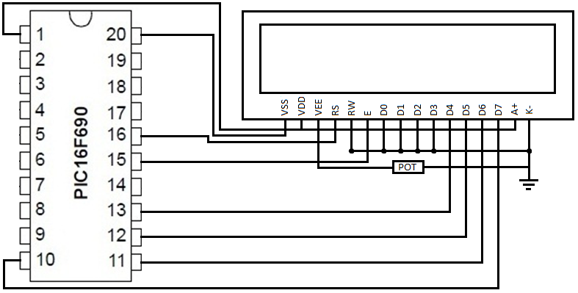
LCD to MCU Connections
Only 6 pins are needed to interface the LCD
Pins D4-D7 are the data pins connection
Enable and register select are the LCD control pins
R/W pin will be grounded since no data will be read from LCD
Pins D0-D3 will be grounded since they are not used in 4-bit mode
4-bit mode will be used because it requires less pins
  Data is sent in nibbles
  Higher nibble is sent first and then the lower nibble is sent

Slide 36
Software Programs
The software used to program the UCF is the mikroC compiler by MikroElektronika. The reason for choosing this compiler is because:
  Ease of use
  Pre-written library functions
  Free
  Documentation
  Support
The software used to convert the C code to a hex file and program it to the PIC chip is PICKit2 by Microchip.

Slide 37
Software Code
The code for the UCF contains the following functions:
  Main
  Interrupt
  ADC
  Shutdown

Slide 38
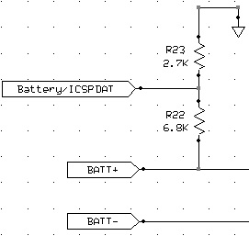
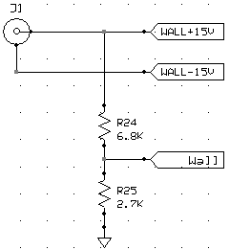
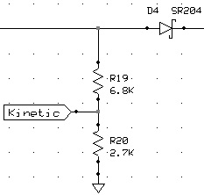
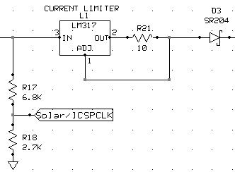
Analog-to-Digital Conversion
Four ADCs are performed by the MCU:
The above voltage dividers provide adjusted values for ADC calculations, and the same resistor values are used for each voltage divider for simplicity and to save program space by using only two variables instead of eight.
Battery ADC
Wall ADC
Kinetic ADC
Solar ADC

Slide 39
Analog-to-Digital Conversion
The ADC function code performs the following steps in order to achieve an accurate value for display to the LCD:
Read raw ADC value from analog port
Multiply the raw value by the reference voltage (+5V)
Divide by 1023 because of 10-bit resolution
Divide by the voltage divider factor Vo/Vi,
where Vo/Vi = R2/(R1+R2)
5. Result gives voltage in millivolts

Slide 40
PCB Design

Slide 41
PCB Design Objectives
Small enough to fit inside UCF enclosure unit
Durable
Low cost
Professional appearance

Slide 42
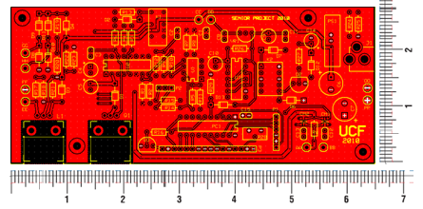
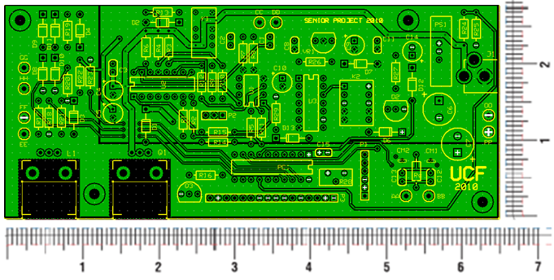
PCB Design
Schematic and PCB Layout were designed using ExpressSCH and ExpressPCB
Entire system is on one PCB
Dimensions of PCB: 6.5” x 2.60”
PCB is a 4-layer board; top and bottom contain signal traces and the two inner planes are for power and ground
Trace sizes range from 0.020” to 0.060” depending on current needs
Primarily through hole components were used

Slide 43
Possible Improvements
Design a smaller PCB and enclosure unit
  Portability
  Cost
Use a microcontroller with more memory capability in order to display more information and calculate a more accurate reading of the battery capacity
  Current measurement hardware has been implemented into design

Slide 44
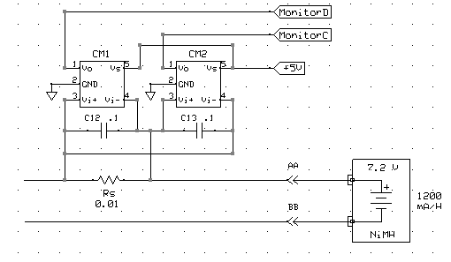
Current Measurement Design
The wall charging schematic consists of:
Current shunt monitor (x2 INA-193)
0.01Ω shunt resistor
Capacitors (x2)

Slide 45
Administrative

Slide 46
Budget
Project Budget
Items | Required | Acquired | Estimated Cost | Actual Cost
DC Motor | 1 | 1 | $10 | $7
Gears | 1 | 1 | $5 | $4
Generator Handle | 1 | 1 | $5 | Free
AC-DC wall adapter | 1 | 1 | $30 | $30
DC-DC converters | 3 | 1 | $70 | $70
LCD | 1 | 1 | $20 | $10
Battery | 2 | 2 | $25 | $20
Solar Cells | 27 | 60 | $100 | $80
Project Housing Material | 1 | 2 | $25 | $50
PCB | 1 | 4 | $100 | $55
Miscellaneous |  |  | $100 | $65
Total |  |  | $490 | $391

Slide 47
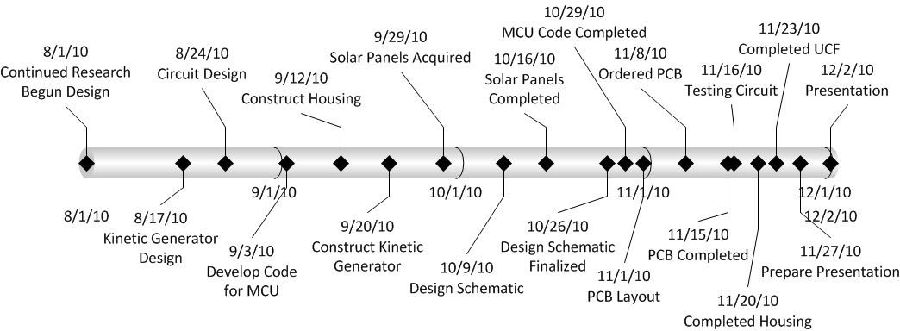
UCF Timeline

Slide 48
Work Distribution
Alfred | Melanie | Mike | Tristan
-----------------------------------Research, Paperwork, and Design-----------------------------------
Battery Design | Kinetic Generator | Wall Adapter | Solar Power
Wall Charging Design | PCB Design/Layout | Programming & Breadboard Prototyping | Mechanical Enclosure Unit
------------------------------------------Integration and Test----------------------------------------------

Slide 49
Questions?

